Slide 1

Object Oriented Programming
Lec # 6 : Operator overloading

Slide 2
Function Overloading
An overloaded function is one which has the same name but several different forms
For example:
We can overload the constructor for the Date class:
default Date d;
Parametrized (3 ints) Date d(9,22,20);
copy Date d1(d);
Parametrized (1 string, 2 ints) Date d(“Sept”,22,2020);

Slide 3
Operator Overloading
The method of defining additional meanings for operators is known as operator overloading
Enables an operator to perform different operations depending upon the type of operands
The basic operators i.e. +, -, *, / normally works with basic types i.e. double, float, int, long. (defined in C++)
So, how can these operators be applied to user-defined data types?

Slide 4
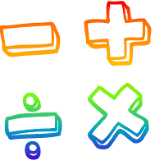
Operator Overloading
The operator “+” also has different semantics depending on the type of its “arguments”
Example
int i=5, j=7;
i + j; //add two int
double d=5.4, e=3.0;
i + d; //add an int and a double
d + e; //add two doubles

Slide 5
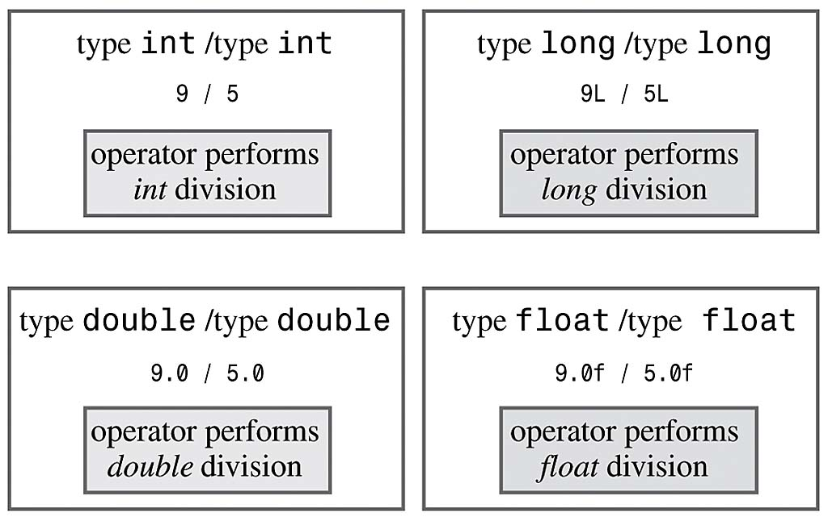
Operator Overloading
Example (already overloaded operator / ):
Same operator has different meaning for different operands

Slide 6
Operator Overloading Motivation
Don’t want to create new operators for user-defined data types
Conclusively, Operator overloading:
Enabling C++’s operators to work with class objects
Using traditional operators with user-defined objects
Requires great care; when overloading is misused, program difficult to understand
Examples of already overloaded operators:
Operator << is both the stream-insertion operator and the bitwise left-shift operator

Slide 7
How to Overload an Operator?
An operator can be overloaded by declaring a special member function in the class
Name of the member function is operator that is followed by operator symbol e.g., operator+, operator/, etc.
Can be independent function (except for the following operators: ( ), [ ], -> or any of the assignment operators)
Can be a class’s member function (must be non-static)
Notes:
Can be a member function (must be non-static): to be able to work on objects of the class
If you plan on implementing ->, () or [] they are naturally member methods. The binary operators = (assignment), [] (array subscription), -> (member access), as well as the n-ary () (function call) operator, must always be implemented as member functions, because the syntax of the language requires them to.

Slide 8
How to Overload an Operator?
Member function: If the left operand of that particular class is an object of the same class, then the overloaded operator is said to be implemented by a member function.
Non-member function: If the left operand of that particular class is an object of a different class, then the overloaded operator is said to be implemented by a non-member function
Notes:
A unary operator @, applied to an object x, is invoked either as operator@(x) [non member implementation] or as x.operator@() [member implementation].
A binary infix operator @, applied to the objects x and y, is called either as operator@(x,y) [non-member implementation] or as x.operator@(y) [member implementation]

Slide 9
Overload as Member or Non-Member Function
If it is a unary operator, implement it as a member function.
If a binary operator treats both operands equally (it leaves them unchanged), implement this operator as a non-member function.
If a binary operator does not treat both of its operands equally (usually it will change its left operand), it might be useful to make it a member function of its left operand’s type

Slide 10
Syntax to Overload an Operator
returnType operatoropsymbol(parameters) { }
↑ ↑ ↑ ↑ any type keyword operator symbol function body
Example:
void operator+ (parameters) { }
↑ ↑ ↑ ↑ any type keyword operator symbol function body
return-type may be whatever the operator returns
Operator symbol may be any over-loadable operator

Slide 11
Operator Overloading
Operators are really functions
They have arguments, they return values
The only difference is that their names take on a specific form:
Operator+, operator[ ]
Overloading provides concise notation:
// without operator overloading object2 = object1.add(object2);
// with operator overloading
object2 = object2 + object1;

Slide 12
Restriction on Operator Overloading
With operator overloading we cannot change:
How operators act on built-in data types:
i.e., cannot change integer addition
Precedence of operator (order of evaluation)
Use parentheses to force order-of-operations
Association rules (left-to-right or right-to-left evaluation)
Number of operands
i.e., & is unary, only acts on one operand
Cannot create new operators
Operators must be overloaded explicitly:
i.e., Overloading + , does not overload +=
Notes:
at least one of the operands has to be of a user-defined type.

Slide 13
Restriction on Operator Overloading
Notes:
The comma operator (represented by the token, ) is a binary operator that evaluates its first operand and discards the result, it then evaluates the second operand and returns this value (and type). The comma operator has the lowest precedence of any C operator, and acts as a sequence point.
->* is an operator to operate on function pointers

Slide 14
Operator =, operator &
Operator = and operator & are overloaded implicitly for every class, so they can be used for each class objects.
operator = performs member-wise copy of the data members.
operator & returns the address of the object in memory.

Slide 15
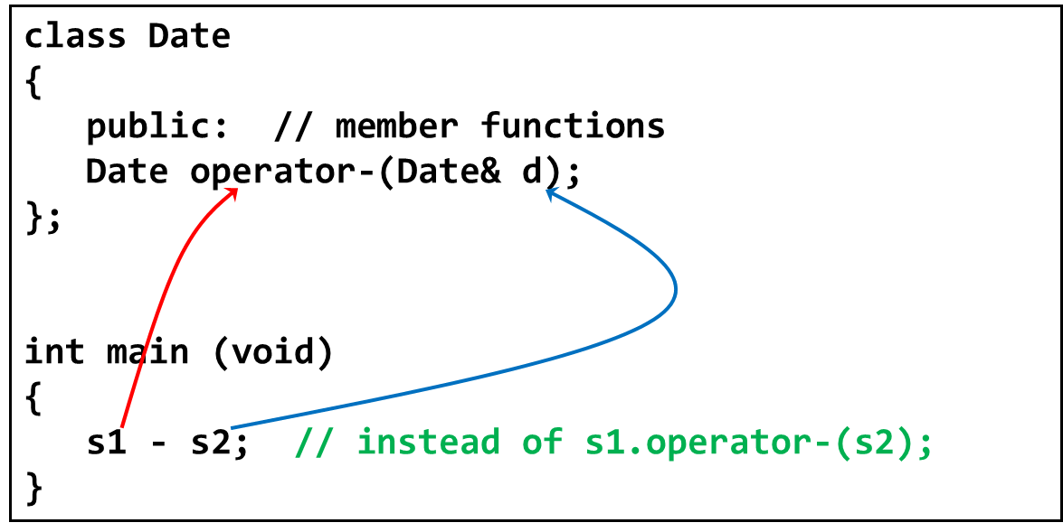
Invoking Objects
If the operator is binary but there is only one explicit argument, the calling object is assumed to be the left operand

Slide 16
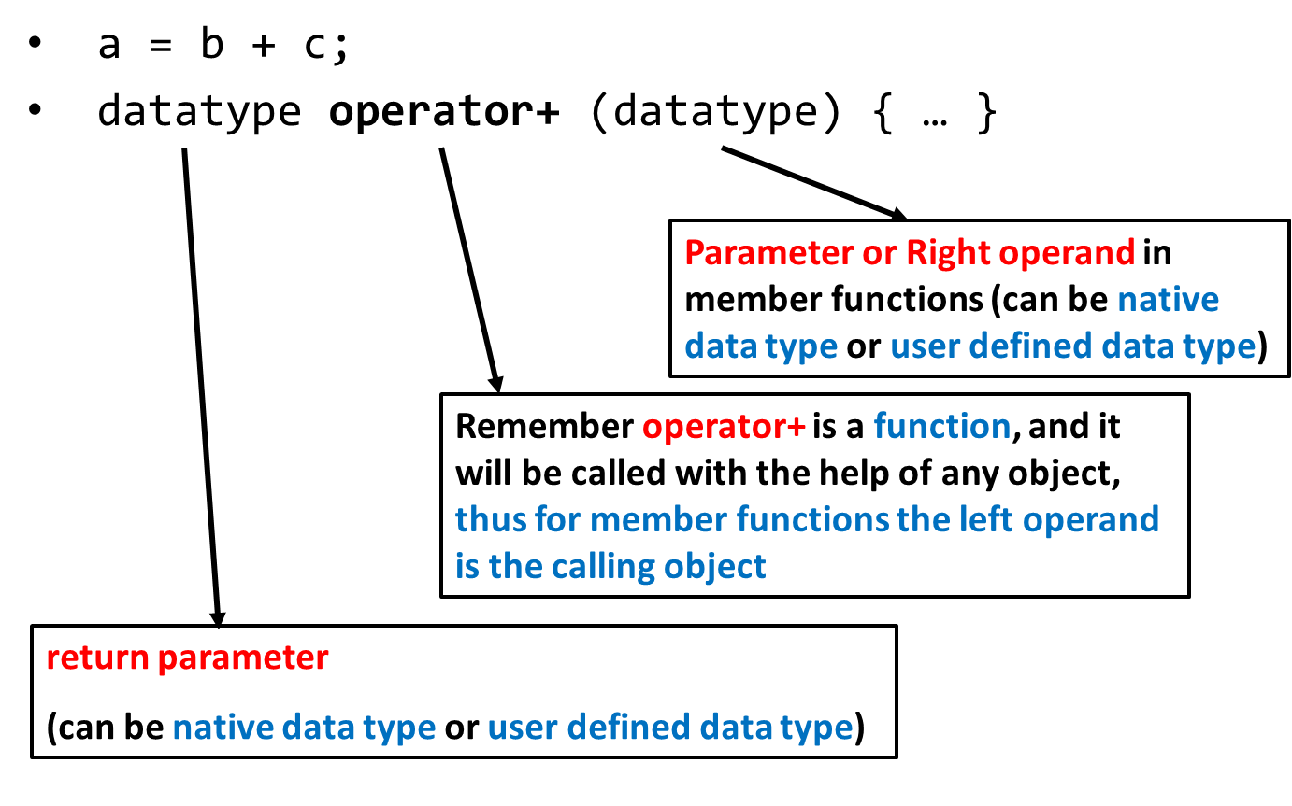
Operator Overloading Syntax

Slide 17
Operator Overloading Syntax
datatype operator+ (datatype)
Example (1): parameter of primitive data type
return value of primitive data type
class myClass
{
int operator+ ( int );
}
int main ( )
{
int a,b=5;
myClass object1;
a = object1 + b;
}

Slide 18
Operator Overloading Syntax
datatype operator+ (datatype)
Example (2): parameter of user defined data type
return value of primitive data type
class myClass
{
int operator+ ( myClass &a );
}
int main ( )
{
int a;
myClass object1, object2;
a = object1 + object2;
}

Slide 19
Operator Overloading Syntax
datatype operator+ (datatype)
Example (3): parameter of primitive data type
return value of user defined data type
class myClass
{ myClass operator+ ( int ); }
int main ( )
{
int a = 5;
myClass object1, object2;
object2 = object1 + a;
}

Slide 20
Operator Overloading Syntax
datatype operator+ (datatype)
Example (4): parameter of user defined data type
return value of user defined data type
class myClass
{
myClass operator+ ( myClass &a );
}
int main ( )
{
myClass object1, object2, object3;
object3 = object1 + object2;
}

Slide 21
Operator Overloading
Relational operators are also binary and can be overloaded in the same way
< , > , <= ,>= , ==
To add operator functionality in the class
First create a function for the class
Set the name of the function with the operator name
operator+ for the addition operator ‘+’
operator> for the comparison operator ‘>’

Slide 22
Overloading > operator
bool Employee::operator>(Employee& e)
{
return(seniority > e.getSeniority());
}
called from the program like this:
if (emp1 > emp2)

Slide 23
Implementing Overloaded Operators
The compiler uses the types of arguments to choose the appropriate overloading.
int v1, v2;
v1 + v2; // int +
float s1, s2;
s1 + s2; // float+

Slide 24
Extended Example
class Employee
{
private:
int idNum;
double salary;
public:
Employee(int id, double salary);
double addTwo (Employee& emp);
double operator+ (Employee& emp);
double getSalary() { return salary; }
};

Slide 25
The member functions ‘addTwo’ and operator+
//function notation
double Employee::addTwo(Employee& emp)
{
double total;
total = this->salary + emp.getSalary();
return total;
}
//operator overloading notation
double Employee::operator+(Employee& emp)
{
double total;
total = this->salary + emp.getSalary();
return total;
}

Slide 26
Using the Member Functions
double sum;
Employee Clerk (111, 10000), Driver (222, 6000);
// these three statements do the same thing
sum = Clerk.addTwo(Driver);
sum = Clerk.operator+(Driver);
sum = Clerk + Driver;
// the syntax for the last one is the most natural
// and is easy to remember because it is consistent
// with how the + operator works for everything else

Slide 27
Multiple Operators
Often, you may need to reference an operator more than once in an expression:
Example:
total = a + b + c;
But this can cause problems when operator overloading is involved
See next example…

Slide 28
Client Code for Class Employee
void main()
{
Employee Clerk(115, 20000.00);
Employee Driver(256, 15500.55);
Employee Secretary(567, 34200.00);
double sum;
sum = Clerk + Driver + Secretary;
cout << “Sum is “ << sum;
}

Slide 29
The Problem
Operator + is left to right associative, so Clerk and Driver are added. The result is a double.
double + Secretary; //ERROR
The overloaded operator+ function is a member of the employee class.
Left operand MUST be an object of Employee class.

Slide 30
The Problem Gets Worse
A member function CANNOT overload an operator like this:
Primitive data type + User-defined data type //ERROR
double + Employee
sum = num + Secretary; // why not?
Whenever an operator is overloaded as a member function. The left operand must be of that SAME class.
Here the left operand is a double, we cannot create an overloaded function in the double class
There are two ways to make this work for
non-member function
Friend function (we will visit that later)

Slide 31
Solution 1
sum = Clerk + Driver + Secretary;
Make sure that your operator+ function never returns a double (or any other primitive type).
An operator to add Employees should return an Employee object.
Good practice that all your arithmetic binary operators
(+ - * / %) when overloaded should return an object

Slide 32
Solution 1
Employee class and objects
class Employee
{
private:
int idNum;
double salary;
public:
Employee(int id, double salary);
Employee operator+ (Employee& emp);
double getSalary() { return salary; }
}

Slide 33
Solution 1
Employee Employee::operator+(Employee& emp)
{
double sal = salary + emp.salary;
Employee total(0, sal);
return total; //returns an object
}
void main()
{
Employee Clerk(115, 20000.00);
Employee Driver(256, 15500.55);
Employee Secretary(567, 34200.00);
Employee sum(0, 0.0);
sum = Clerk + Driver + Secretary;
}

Slide 34
Solution 2
sum = Clerk + Driver + Secretary;
Make a non-member operator+ function that returns an Employee object.

Slide 35
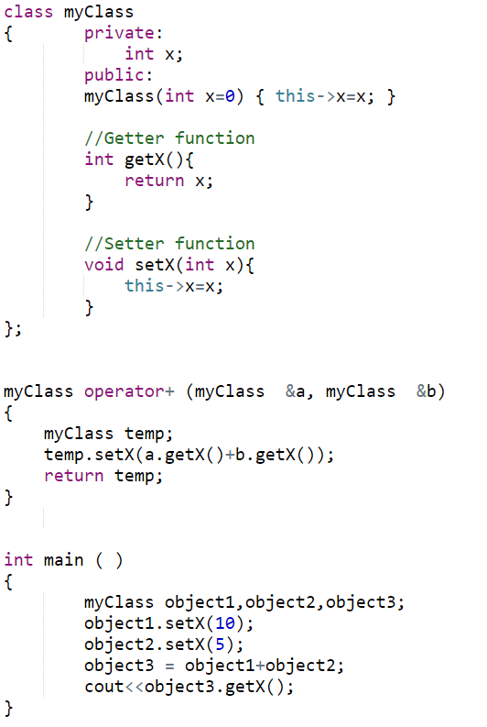

Slide 36
Assignment Operator =
Operator = is overloaded implicitly for every class, so they can be used for each class objects.
Recall default copy constructor
operator = performs member-wise copy of the data members.
However, there is a problem with implicitly overloaded operator=
Recall shallow copy

Slide 37
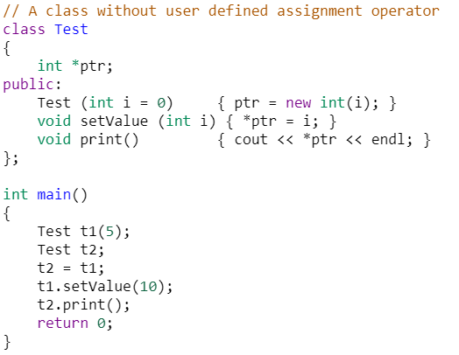
Using implicit Overloaded Assignment Operator
Output = 10

Slide 38
Assignment Operator =
Assignment operator can ONLY be overloaded as a member function
class Employee
{ private:
int idNum;
double salary;
public:
Employee ( ) { idNum = 0, salary = 0.0; }
void setValues (int a, int b);
void operator= (double); //prototype
}
void Employee::setValues ( int idN , double sal )
{
salary = sal; idNum = idN;
}
void Employee::operator= (double sal)
{ salary = sal; }

Slide 39
Assignment Operator =
int main ( )
{
Employee emp1;
emp1.setValues(10,33.5);
Employee emp2;
emp2 = 44.6; // emp2 is calling object
}
Overloaded as a member function so left operand must be an object of the same class
Right operand a double (parameter of the overloaded = function)

Slide 40
Assignment Operator =
class Employee
{ private:
int idNum;
double salary;
public:
Employee ( ) { idNum = 0, salary = 0.0; }
void setValues (int a, int b);
double getSalary() { return salary }
void operator= (Employee &emp );
}
void Employee::setValues ( int idN , double sal )
{ salary = sal; idNum = idN; }
void Employee::operator = (Employee &emp)
{ salary = emp.getSalary(); }

Slide 41
Assignment Operator =
int main ( )
{
Employee emp1;
emp1.setValues(10,33.5);
Employee emp2;
emp2 = emp1; // emp2 is calling object
}

Slide 42
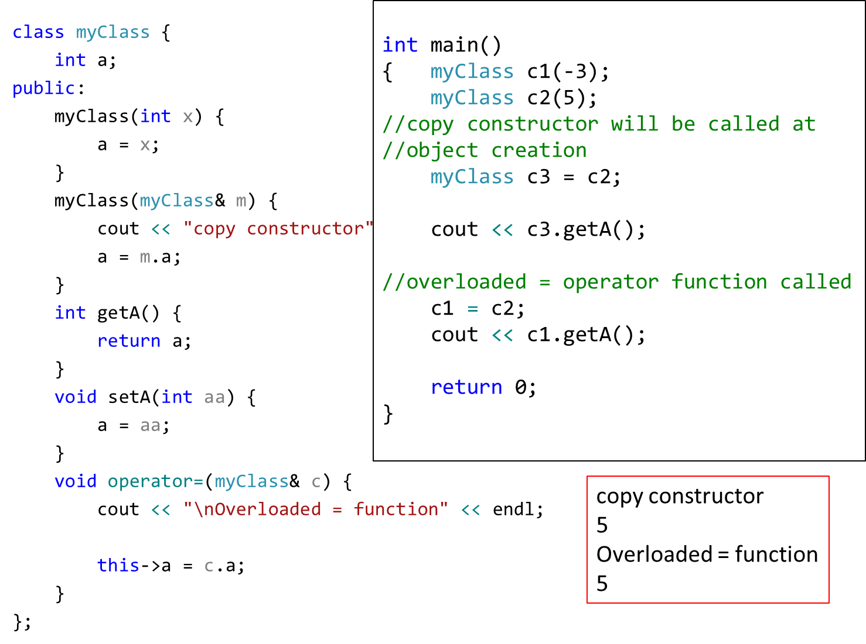

Slide 43
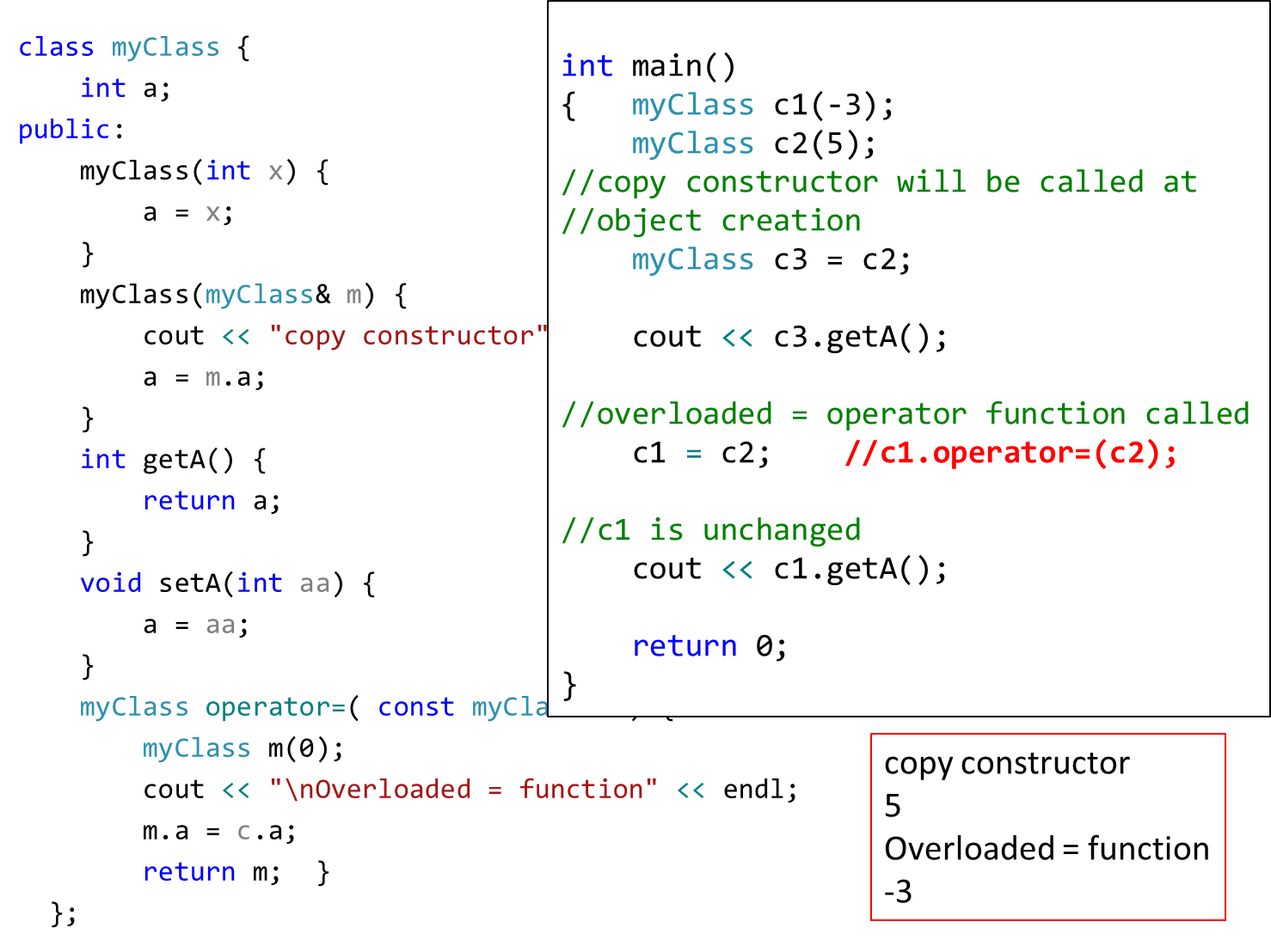

Slide 44
Comparison Operator ==
class Employee
{ private:
int idNum;
double salary;
public:
Employee ( ) { idNum = 0, salary = 0.0; }
void setValues (int a, int b);
double getSalary() { return salary }
bool operator== ( Employee &emp );
}
void Employee::setValues ( int idN , double sal )
{ salary = sal; idNum = idN; }
bool Employee::operator == (Employee &emp)
{ return (salary == emp.getSalary()); }

Slide 45
Comparison Operator ==
class Employee
{ private:
int idNum;
double salary;
public:
Employee ( ) { idNum = 0, salary = 0.0; }
void setValues (int a, int b);
double getSalary() { return salary }
}

Slide 46
Comparison Operator ==
int main ( )
{
Employee emp1;
emp1.setValues(10,33.5);
Employee emp2;
emp2.setValues(10,33.1);
if ( emp2 == emp1 )
cout <<“Both objects have equal value”;
else
cout <<“objects do not have equal value”;
}

Slide 47
Operator Overloading Syntax
Syntax of an overloaded operator function:
datatype operator+ (datatype)
However, for some operators, this syntax will be slightly different:
++, -- operators
>>, << operators
& and [ ] operators

Slide 48
Overloading ++ and - -
Operator ++ and -- are different to other operators of C++
We can call them:
either in the form of prefix (++i) before an object
or in the form of postfix (i++) after an object
But in both cases, the calling object will be i.

Slide 49
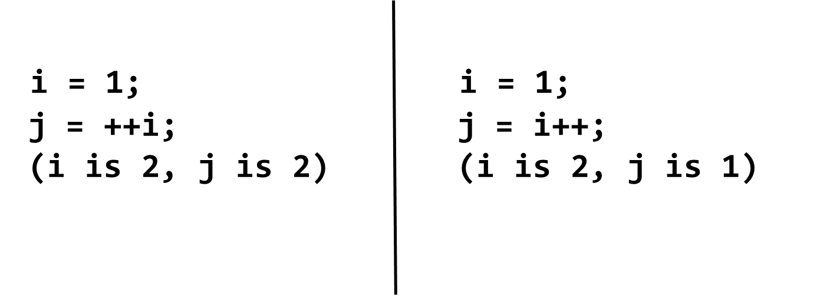
i++ and ++i ?
Prefix makes the change, and then processes the variable
Postfix processes the variable, then makes the change.

Slide 50
Overloaded ++
class Inventory
{
private:
int stockNum;
int numSold;
public:
Inventory(int stknum, int sold);
void operator++();
};
void Inventory::operator++()
{
numSold++;
}

Slide 51
Use of the operator ++
int main ( )
{
Inventory someItem(789, 84);
// the stockNum is 789
// the numSold is 84
++someItem;
Inventory Item2 = ++someItem;
//will this instruction work
// Will not work as the overloaded function does not return anything
}

Slide 52
Overloaded ++
class Inventory
{
private:
int stockNum;
int numSold;
public:
Inventory(int stknum, int sold);
Inventory& operator++();
};
Inventory& Inventory::operator++()
{
Inventory *object = new Inventory(0,0);
numSold++;
object->numSold = numSold;
return(*object);
}

Slide 53
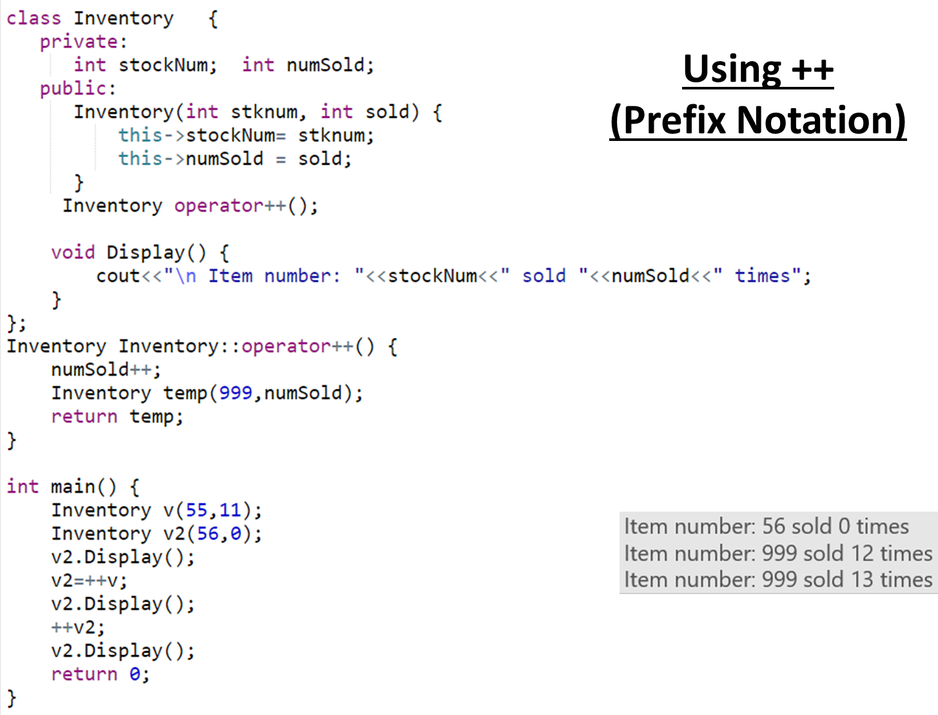

Slide 54
Problem
The definition of the prefix operator is simple. It increments the value before any other operation.
But, how will C++ be able to tell the difference between a prefix ++ operator and a postfix ++ operator?
Answer: overloaded postfix operator will take a dummy argument (just for differentiation between postfix and prefix).

Slide 55
Postfix operator
Inventory& Inventory::operator++() // prefix version
{
Inventory *object = new Inventory(0,0);
numSold++;
object->numSold = numSold;
return(*object);
}
Inventory& Inventory::operator++(int) // postfix version
{
Inventory *object = new Inventory(0,0);
object->numSold = numSold;
numSold++;
return(*object);
}

Slide 56
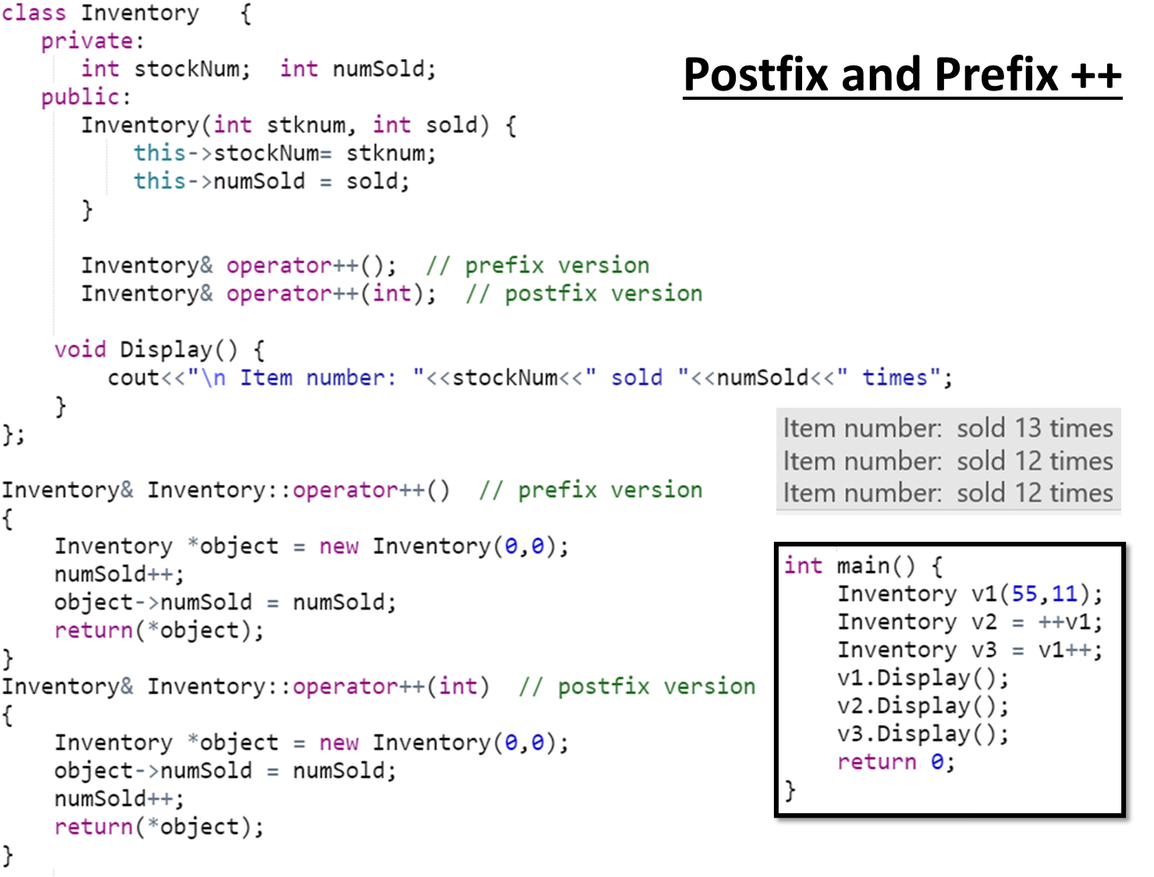

Slide 57
Subscript operator [ ]
With the help of [ ] operator, we can define array style syntax for accessing or assigning individual elements of classes
Student semesterGPA;
semesterGPA[0] = 3.5;
semesterGPA[1] = 3.3;

Slide 58
Subscript operator [ ]
class Student
{ private:
double gpa[8];
public:
Student ()
{ gpa[0]=3.5; gpa[1]=3.2; gpa[2]=4; gpa[3]=3.3;
gpa[4]=3.8; gpa[5]=3.6; gpa[6]=3.5; gpa[7]=3.8;
}
double& opeator[] (int Index);
}
double& Student::operator [ ] (int Index)
{
return gpa[Index];
}

Slide 59
Subscript operator [ ]
int main ( )
{
Student semesterGPA;
semesterGPA[0] = 3.7;
double gpa = semesterGPA[4];
}

Slide 60
Subscript operator [ ]
How does this statement execute?
semesterGPA[0] = 3.7;
The [ ] has higher priority than the assignment operator, therefore semesterGPA[0] is processed first.
semesterGPA[0] calls operator [ ], which then return a reference of semesterGPA.gpa[0].

Slide 61
Subscript operator [ ]
The return value is reference to semesterGPA.gpa[0], and the statement semesterGPA[0] = 3.7 is actually integer assignment
int main ( )
{
Student semesterGPA;
semesterGPA[0] = 3.7;
// the above statement is processed like as
semesterGPA.gpa[0] = 3.7
}

Slide 62
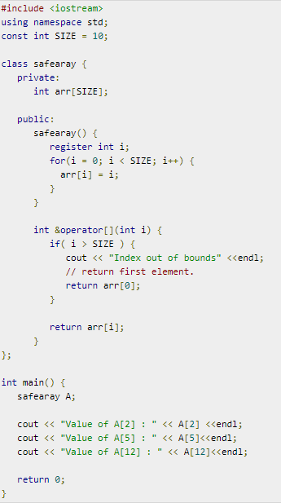
Notes:
Register is a request to compiler to store in register-memory instead of memory. Compiler may or may not do that.
https://www.tutorialspoint.com/cplusplus/subscripting_operator_overloading.htm

Slide 63
Parenthesis operator ()
Can only be overloaded as a member function
Can have any return type
Can have zero or more parameters
Implement any logic in the function

Slide 64
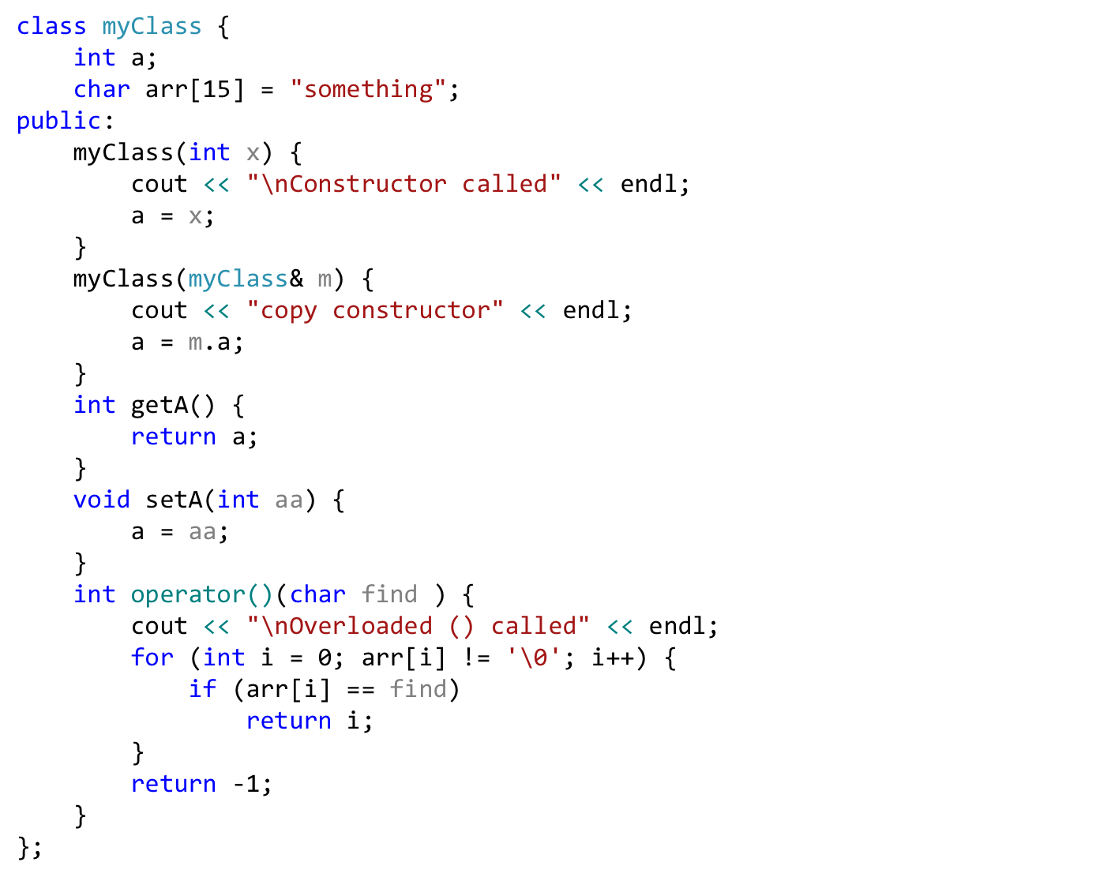
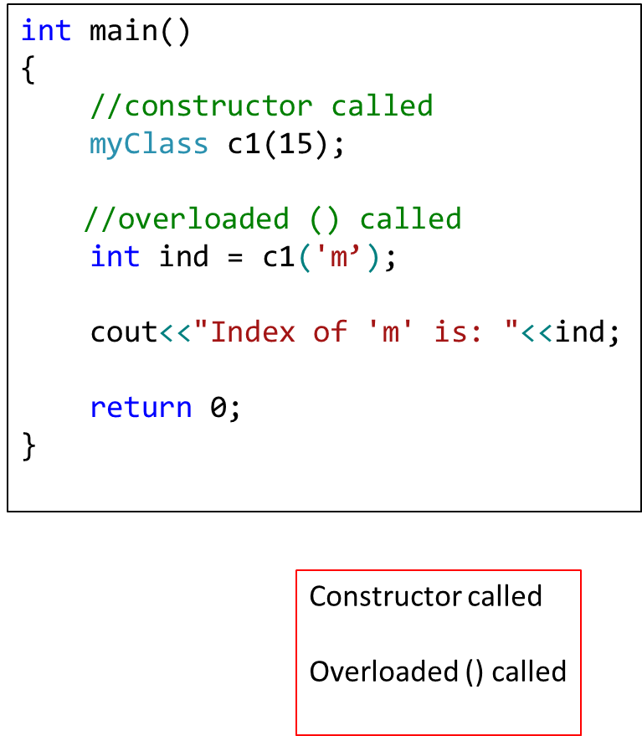

Slide 65
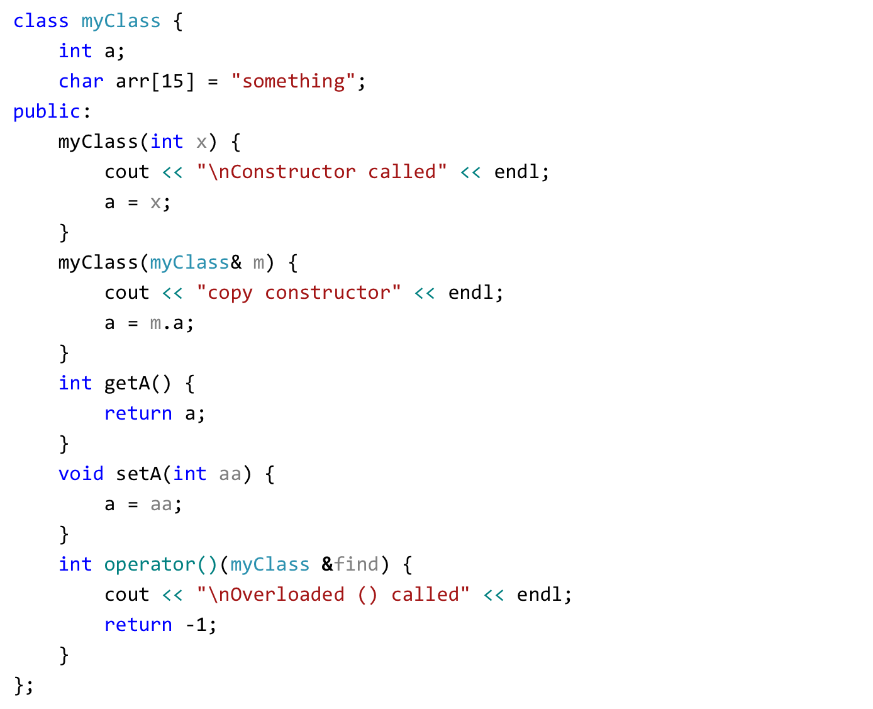
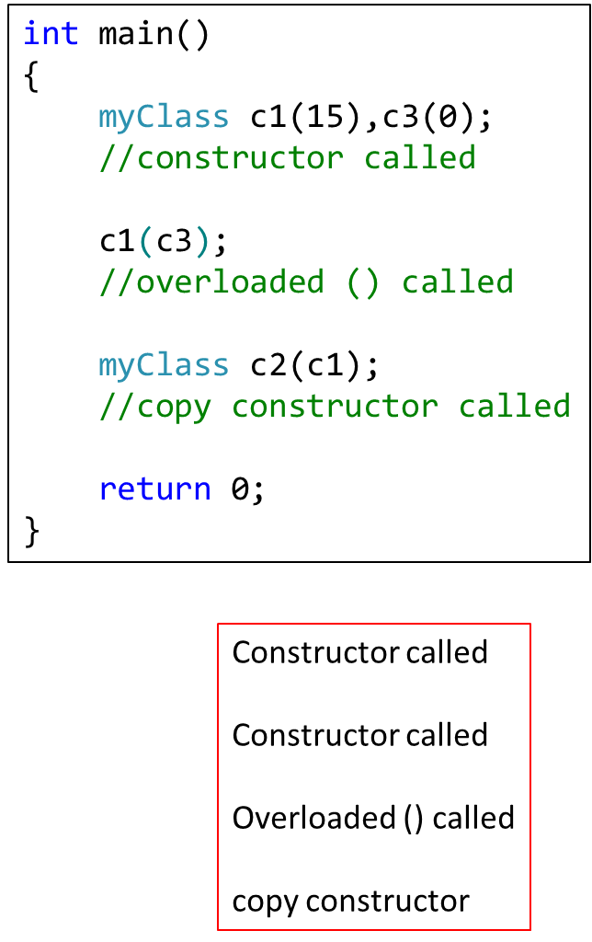

Slide 66
Calling an overloaded operator from native data types
int var;
Point object;
var = var + object;
In above example, it seems that we need to overload + operator for integer (native-data type).
But in operator overloading we can't change the functionality of integer (or any primitive) data type

Slide 67
Calling an overloaded operator from native data types
Friend functions can help solve this problem.
A Friend function does not need an object of a class for its calling.
Thus, with a simple trick we can set parameter1 of an overloaded operator to a native data type and parameter2 to class object.

Slide 68
Friend Functions
Friend functions: can be given special grant to access private and protected members. A friend function can be:
a) method of another class
b) global function
Friends should be used only for limited purpose, too many functions declared as friends with protected or private data access, lessens the value of encapsulation

Slide 69
Calling an overloaded operator from native data types
For friend function the syntax is changed, the first operator is moved from calling object to first parameter of function.
friend datatype operator+ (datatype, datatype)
First parameter (can be native data type or user defined data type)
return parameter (can be native data type or user defined data type)
Second parameter (can be native data type or user defined data type)

Slide 70
Example
class Point
{
private:
float m_dX, m_dY, m_dZ;
public:
Point(float dX, float dY, float dZ)
{
m_dX = dX;
m_dY = dY;
m_dZ = dZ;
}
friend float operator+ (float, Point &);
};

Slide 71
Example
float operator+(float var1, Point &p)
{
return ( var1 + p.m_dX);
}
int main (void)
{
float variable = 5.6;
Point cPoint ( 2, 9.8, 3.3 );
float returnVar;
returnVar = variable + cPoint;
cout << returnVar; // 7.6
return 0;
}

Slide 72
Overloading iostream operators >> and <<
stream insertion operator << is used for output
stream extraction operator >> is used for input
cout is an object of ostream class
cin is an object of istream class
These operators must be overloaded as a global function. And if we want to allow them to access private data members of the class, we must make them friend.

Slide 73
Overloading iostream operators >> and <<
Why these operators must be overloaded as global?
Left operand with << and >> is always going to be cin and cout
if we want to make them a member function, then they must be made members of ostream and istream classes, not a good option.
Therefore, these operators are overloaded as global functions with two parameters, istream/ostream and object of user-defined class.

Slide 74
Overloading iostream operators >> and <<
We can use friend function for overloading iostream operators ( >> or <<).
Usually iostream operators ( >> or << ) are not called from an object of the class
Point p;
cin >> p;
cout << p;
where cin and cout are object of iostream class

Slide 75
Overloading iostream operators >> and <<
We can define the prototype of iostream operators ( >> and << ) inside a class with the help of friend function, and then we can access private data members.
We can also overload these operators without making friend functions

Slide 76
Example
class Point
{
private:
float m_dX, m_dY, m_dZ;
public:
Point(float dX, float dY, float dZ)
{
m_dX = dX;
m_dY = dY;
m_dZ = dZ;
}
friend ostream& operator<< (ostream &out, Point &cPoint);
friend istream& operator>> (istream &in, Point &cPoint);
};

Slide 77
Example
ostream& operator<< (ostream &out, Point &cPoint)
{
out << "(" << cPoint.m_dX << ", " <<
cPoint.m_dY << ", " << cPoint.m_dZ <<")";
return out;
}
istream& operator>> (istream &in, Point &cPoint)
{
in >> cPoint.m_dX;
in >> cPoint.m_dY;
in >> cPoint.m_dZ;
return in;
}

Slide 78
Example
int main (void)
{
cout << "Enter a point: " << endl;
Point cPoint;
cin >> cPoint;
cout << "You entered: " << cPoint << endl;
}

Slide 79
Overloading iostream operators >> and <<
But, what is the advantage of returning references of iostream objects
friend ostream& operator<< (ostream &out, Point &cPoint);
friend istream& operator>> (istream &in, Point &cPoint);
Supports chaining
Point cPoint1, cPoint2;
cin >> cPoint1 >> cPoint2;
In above statement (cin >> cPoint1) returns a reference of cin which is further used for ( cin >> cPoint2)

Slide 80
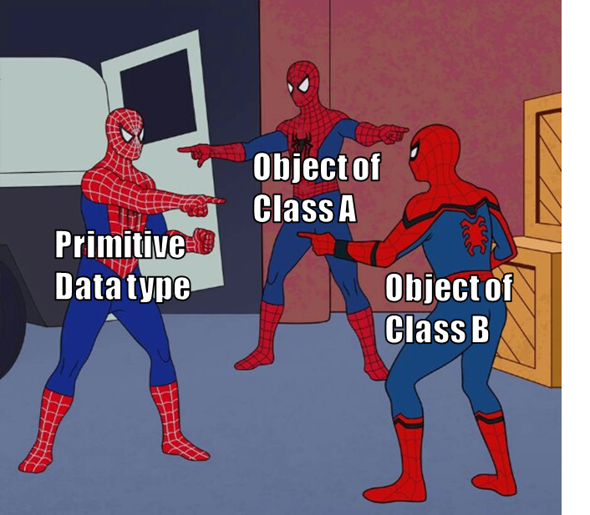
Data Conversion
Conversion between basic types
Conversion between Objects and basic types
Conversion between Objects of different classes

Slide 81
Implicit Conversion b/w Basic Types
When we use two different Types:
intvar = floatvar; //assign float to integer
the compiler calls a special function that converts this value from floating point format to integer
There are many such conversion routines build in C++ compiler and called upon when any such conversion is required.

Slide 82
Explicit Conversion b/w Basic Types
if we want to force compiler to convert data from one native type to other, we can use explicit type casting,
intvar = int(floatvar);
it is obvious in listing that int( ) conversion function will convert from float to int.
This explicit conversion uses same build in routines.

Slide 83
Conversion Between Objects and Basic Types
To convert from a basic type ( i.e., float) to object types (i.e., Distance), we use a constructor with one argument.
Distance(float meters){ }
This function is called when an object of type Distance is created with a single argument.
This conversion allows a float value to be assigned to a Distance type object.
Conversion occurs implicitly

Slide 84
Conversion Between Objects and Basic Types
Distance dist1 = 2.35; // constructor
Above, one argument constructor will be called.
Same conversion can be achieved by providing overloaded ‘=‘ operator which takes a float value as argument.

Slide 85
Conversion From User Defined to Basic
What if want to go from user-defined types(e.g. class Distance) to native type(e.g. float)?
The trick here is to overload the cast operator, creating something called a “Conversion function/operator”.
operator float() {
return floating_rep;
}
NOTE: the conversion function does not need return type
Conversion functions have no arguments, and the return type is implicitly the conversion type

Slide 86
Conversion From User Defined to Basic
This operator takes the value of the distance object of which it is a member, converts this value to a float value and returns this value.
This operator can be called like this:
Distance dist2;
float floatmtrs = float(dist2); //explicit conversion
float floatmtrs = dist2; //implicit conversion
both statements have exactly the same effect.

Slide 87
Conversion From User Defined to Basic
class Employee
{ private:
float salary;
public:
Employee ( float sal ) { salary = sal; }
operator float();
}
Employee::operator float( )
{
return salary;
}

Slide 88
Conversion From User Defined to Basic
int main ( )
{
Employee emp1(33.5);
float value = float(emp1);
cout << value; // 33.5
}

Slide 89
Conversion between Objects of Different Classes
Both methods shown before can be applied to conversion between objects
one argument constructor
conversion function

Slide 90
Example
There are two classes, Polar and Rec.
We want to be able to convert an object of type Polar to an object of type Rec.
Rec rec;
Polar pol;
rec = pol;
provide one argument constructor in class Rec.

Slide 91
Example
Rec(Polar p){
//process p’s data and convert(assign)
//it into object Rec.
}
rec = pol;
/*one argument constructor will be called to perform the conversion*/

Slide 92
Consequences of Operator Overloading and Conversion
With the help of Operator overloading we can create entirely new language.
For example for a = b + c we can implement a new methodology on user-defined types.
But care should be taken as doing something different than native data types could make your code hard to read and understand

Slide 93
Show Restraint
Make sure that user of your class will easily know the purpose of overloading an operator.
Sometimes it make more sense to use functions, as their names may suggest what they are to perform.
Use overloaded operator cautiously and only when the usage is obvious.

Slide 94
String Library
We will use operator overloading to build String library
Overloaded Operators
= (for text assignment)
== (for comparison between two strings)
ostream and istream (for cin and cout)
+ (for adding two strings)
[ ] (for retrieving or changing single character in string)

Slide 95
String Library
class String
{
private:
char *text;
public:
String(char *str)
{
text = new char[strlen(str)];
strcpy(text,str);
}
bool operator==(String &str);
bool operator==(char *str);
String& operator+(String &str);
String& operator+(char *str);
void operator= (char *str);
char& operator[] (int Index);
friend ostream& operator<<(ostream &,String &str);
friend istream& operator>>(istream &,String &str);
};

Slide 96
String Library
bool String::operator == ( char *str )
{
bool val;
val = strcmp(text,str);
if ( val == 0 )
return true;
else
return false;
}
bool String::operator == ( String &par)
{
bool val;
val = strcmp(text,par.text);
if ( val == 0 )
return true;
else
return false;
}

Slide 97
String Library
String& String::operator + (String &par)
{
String iSt = "";
int length = 0;
length = strlen(text);
length += strlen(par.text);
iSt.text = new char[length];
strcpy(iSt.text,text);
strcat(iSt.text,par.text);
return iSt;
}

Slide 98
String Library
String& String::operator + (char *str)
{
String iSt = "";
int length = 0;
length = strlen(text);
length += strlen(str);
iSt.text = new char[length];
strcpy(iSt.text,text);
strcat(iSt.text,str);
return iSt;
}

Slide 99
String Library
void String::operator = (char *str)
{
text = new char[ strlen(str) ];
strcpy(text,str);
}
char& String::[] (int Index)
{
return text[Index];
}
// String string1 = “hello”;
// string1[0] = ‘a’;
// string1.text[0] = ‘a’;
// char c = string1[0];

Slide 100
String Library
ostream& operator<< (ostream &out, String &str)
{
out << str.text;
return out;
}
istream& operator>> (istream &in, String &str)
{
char temp[200];
in >> temp;
text = new char[strlen(temp)];
strcpy(text,temp);
return in;
}

Slide 101
String Library
int main ( )
{
String string1 = “hello”;
String string2 = “”;
string1 = “hello world”;
cout << “Enter string 2 text” << endl;
cin >> string2;
if ( string1 == string2 )
cout << “Both strings are equal” << endl;
string2[0] = ‘a’;
string2[1] = ‘b’;
cout << “The second string is “ << string2 << endl;
cout << the first character is “<< string1[0] << endl;
}

